Slide 1
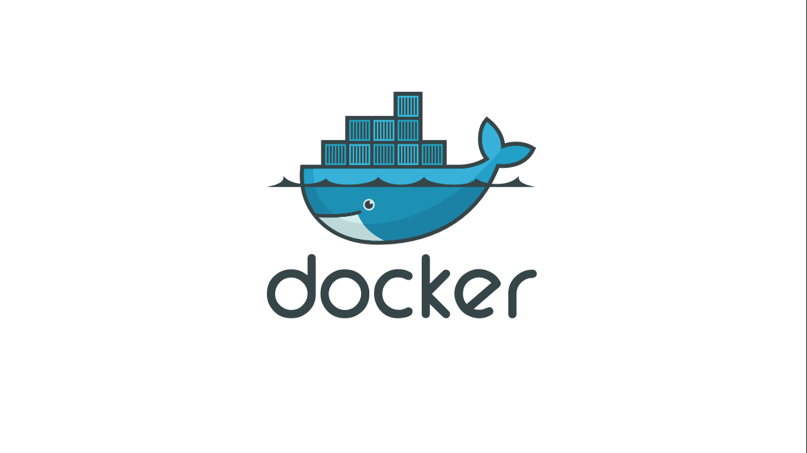

Slide 2
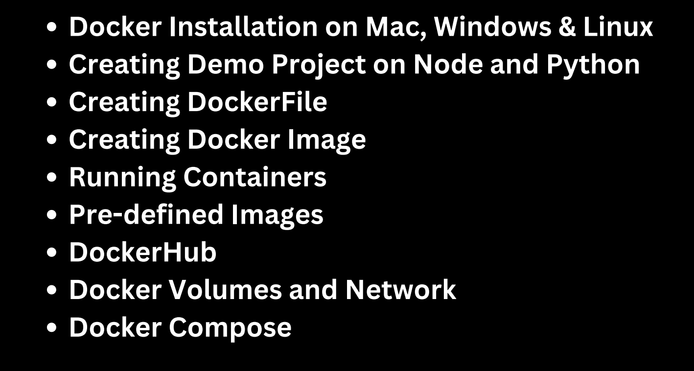

Slide 3
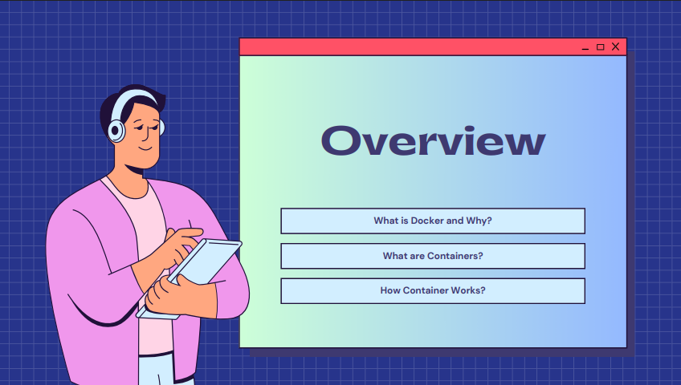

Slide 4
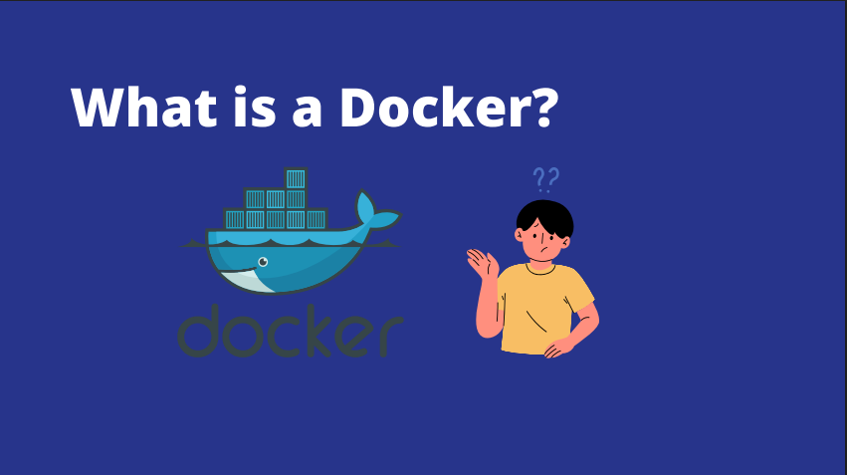

Slide 5
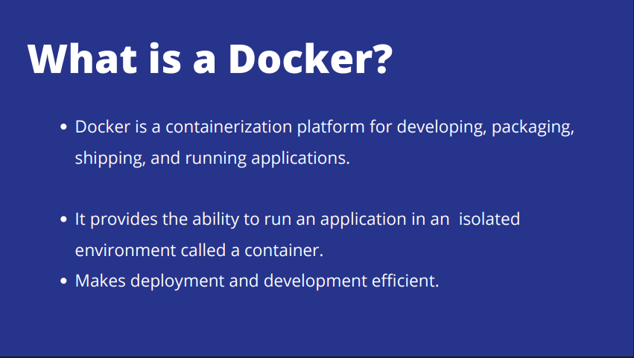

Slide 6


Slide 7


Slide 8
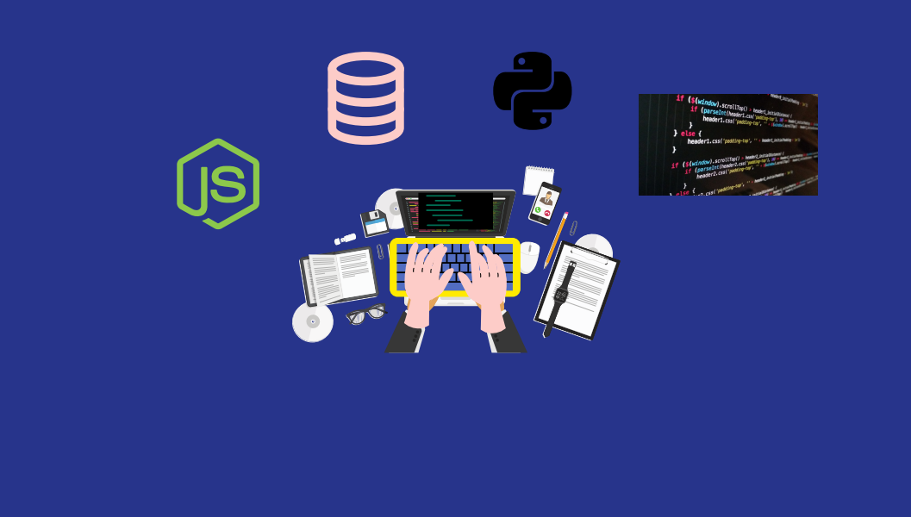

Slide 9


Slide 10
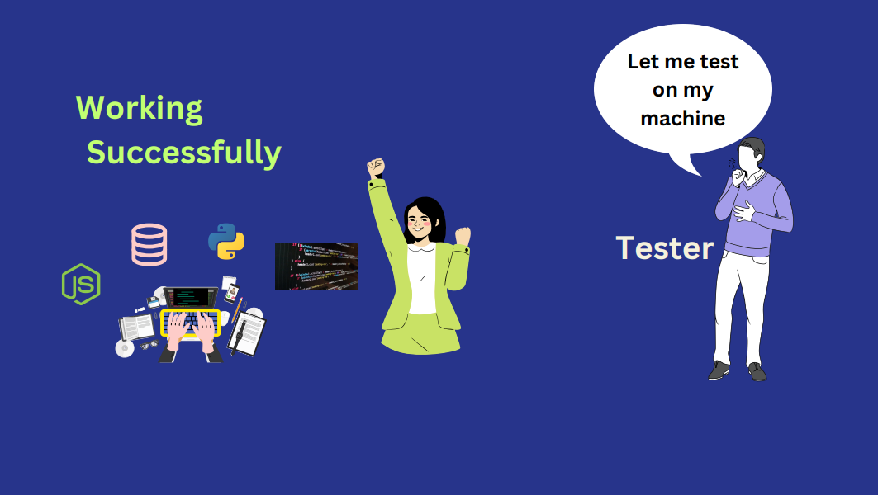

Slide 11
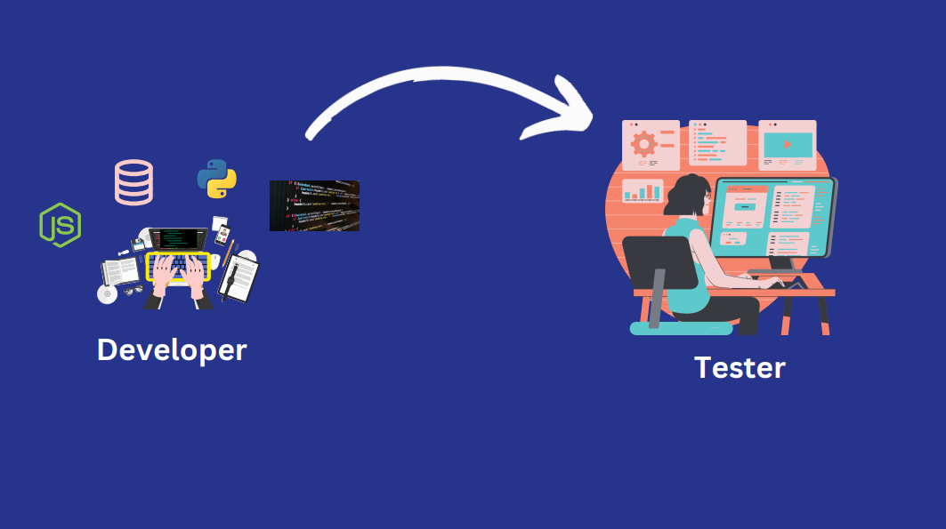

Slide 12
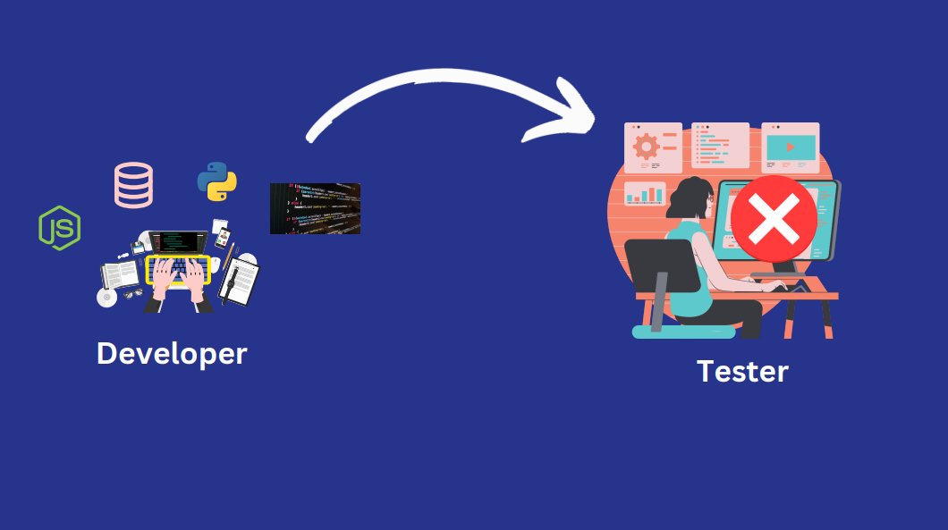

Slide 13
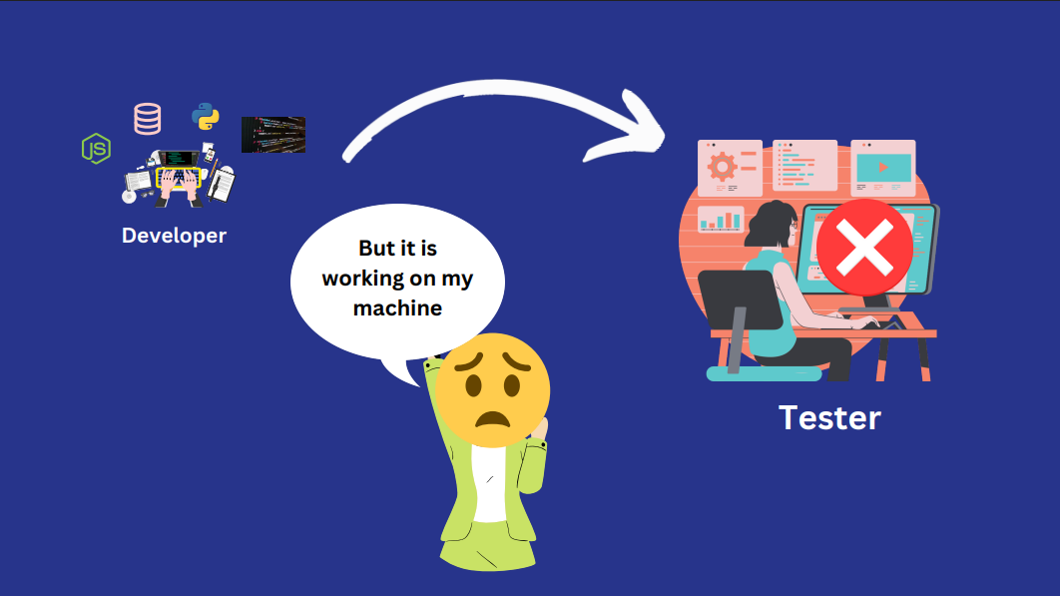

Slide 14


Slide 15


Slide 16
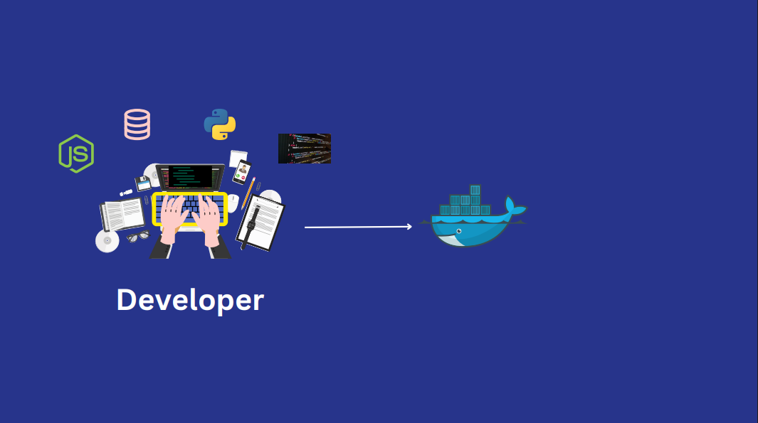

Slide 17
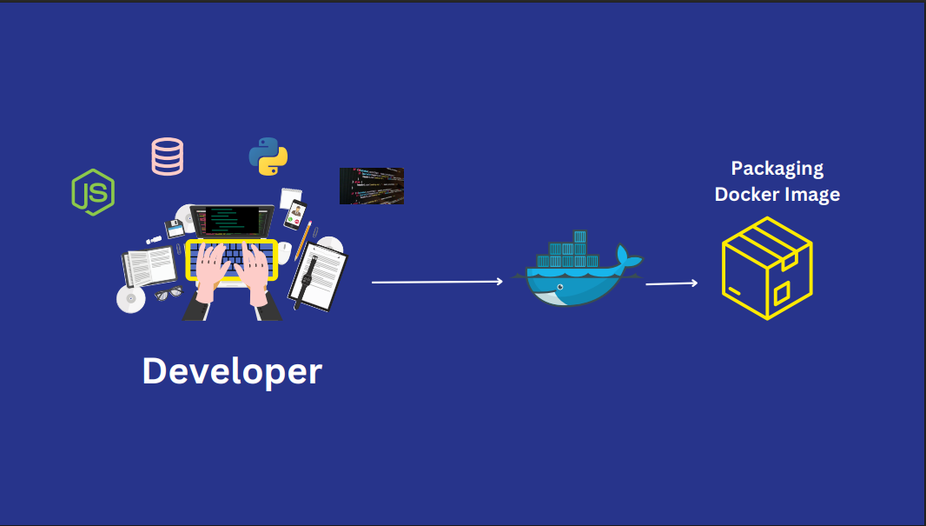

Slide 18
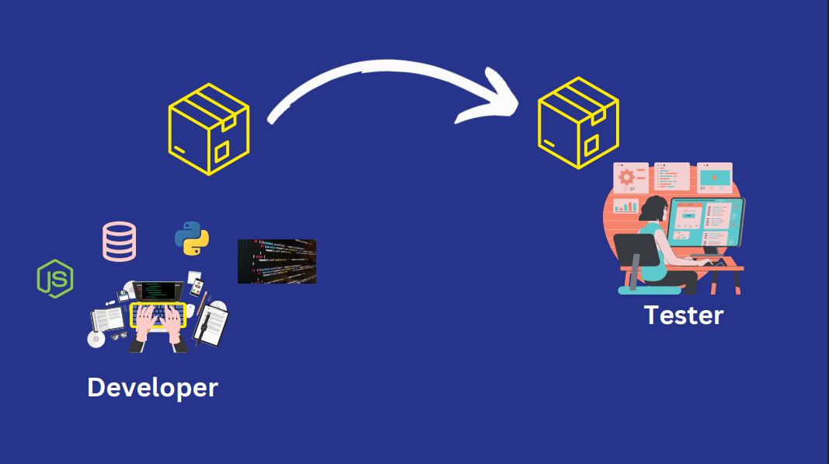

Slide 19
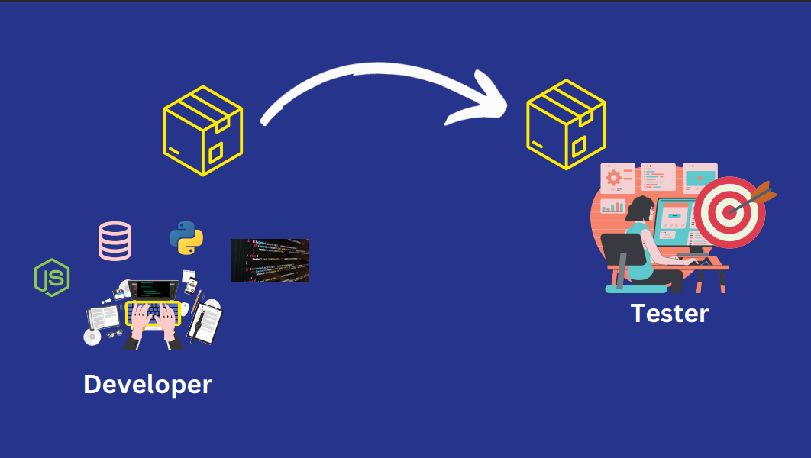

Slide 20


Slide 21
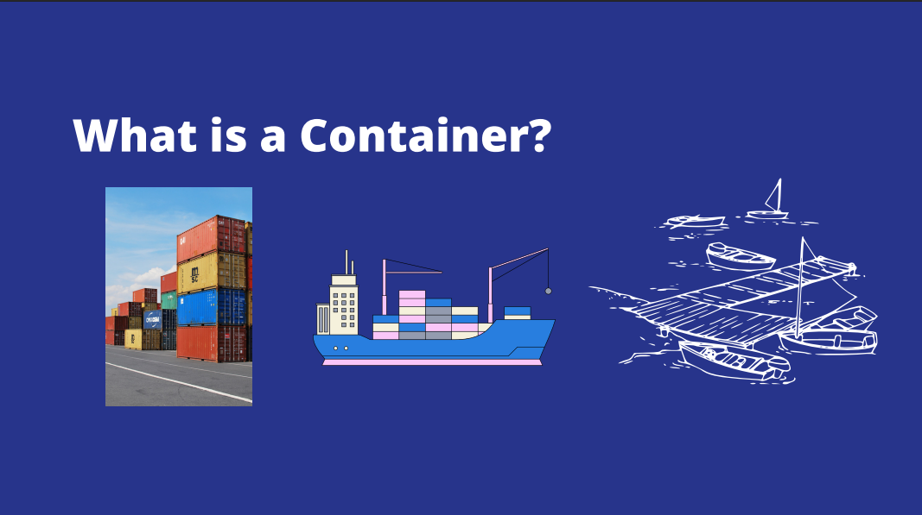

Slide 22
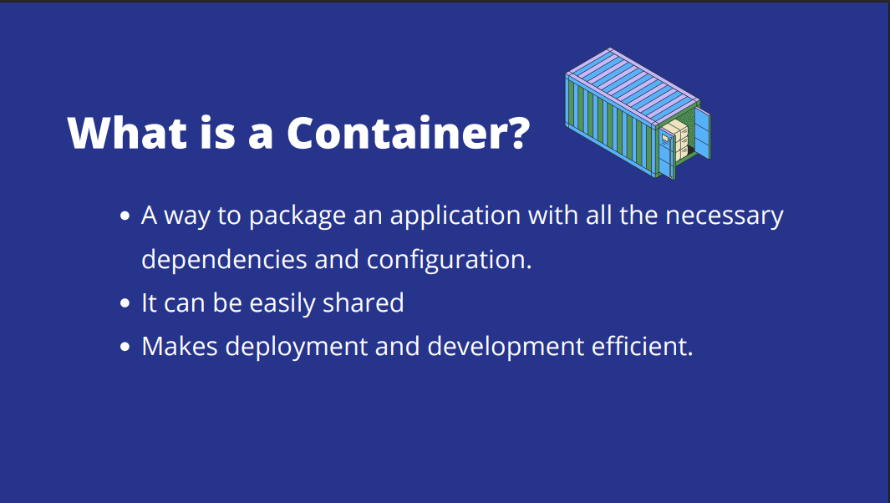

Slide 23
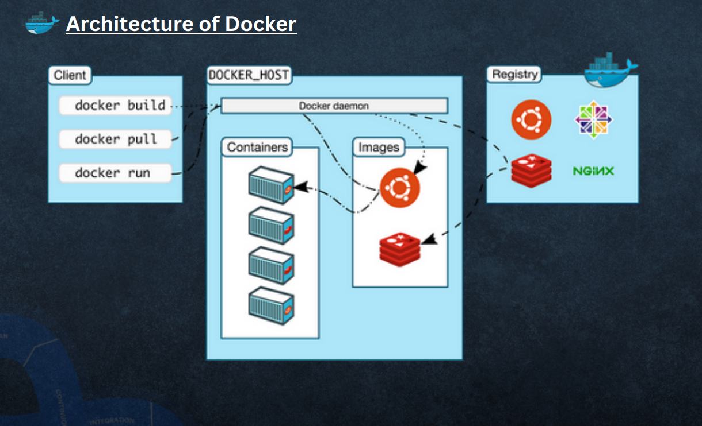

Slide 24
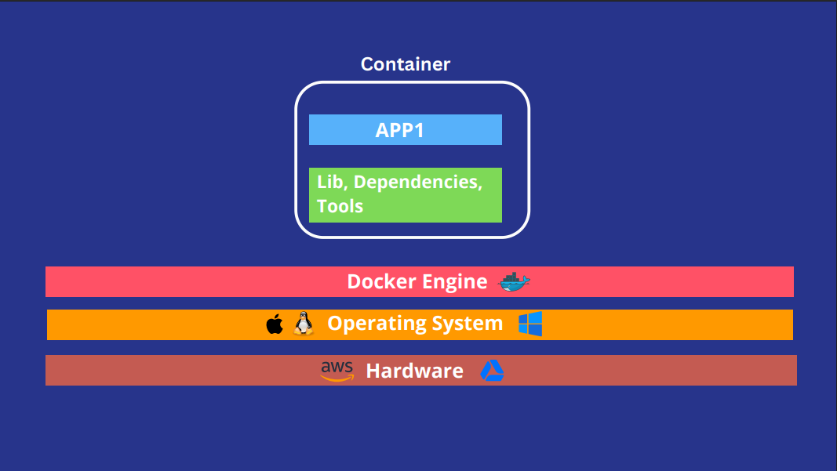

Slide 25
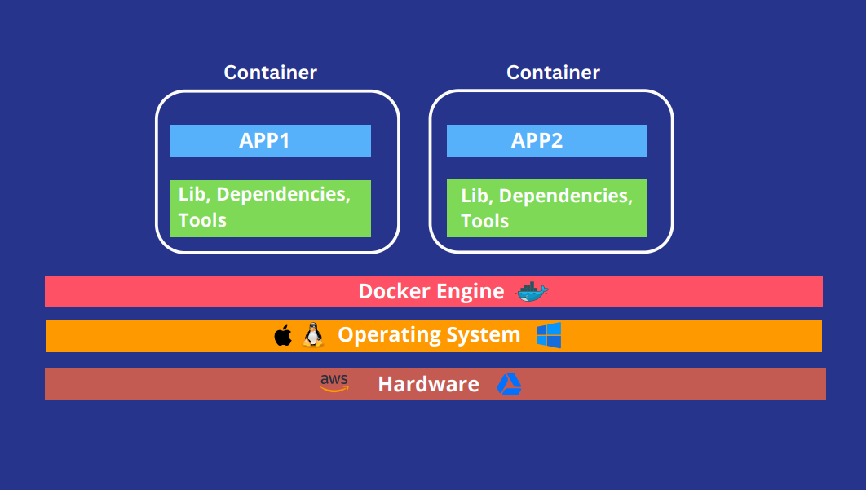

Slide 26
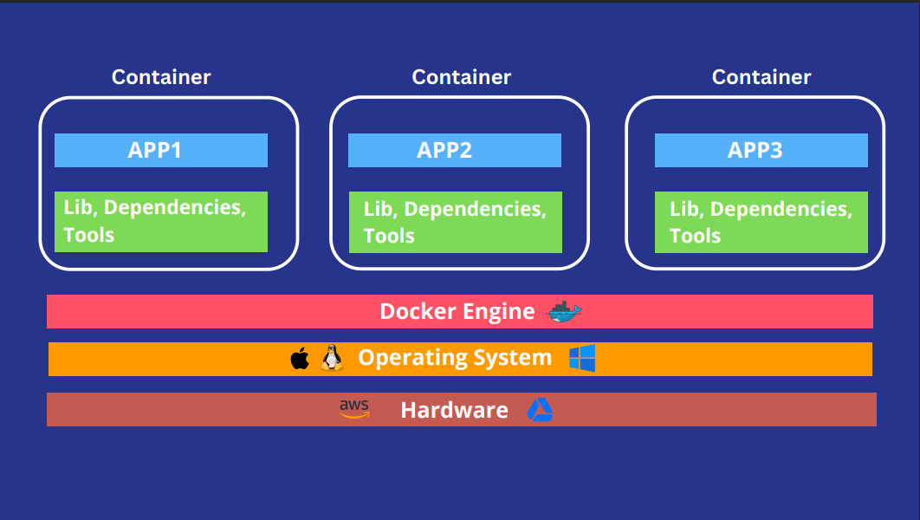

Slide 27
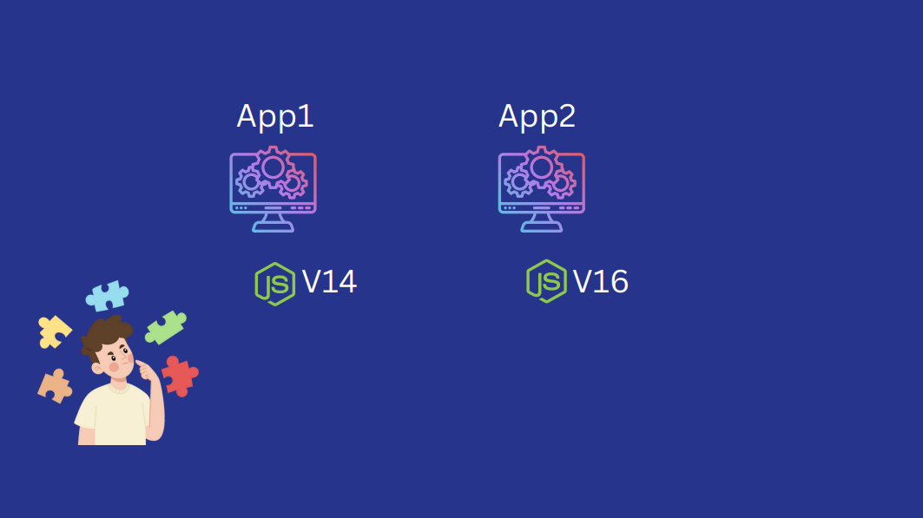

Slide 28
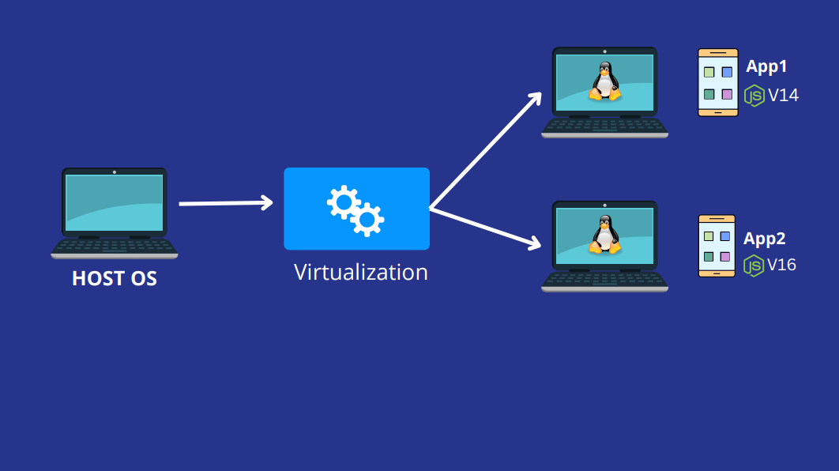

Slide 29
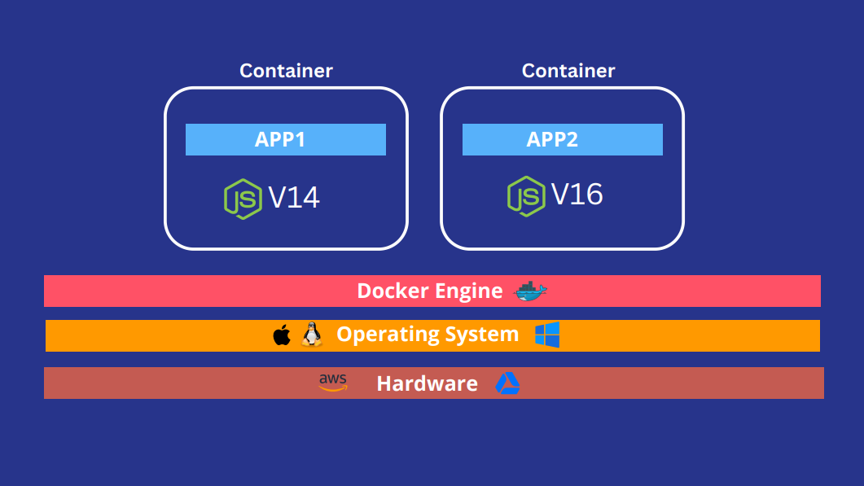

Slide 30
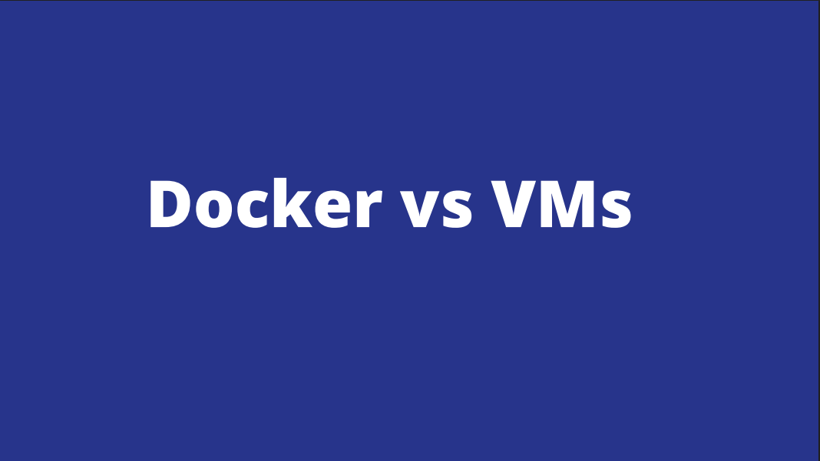

Slide 31
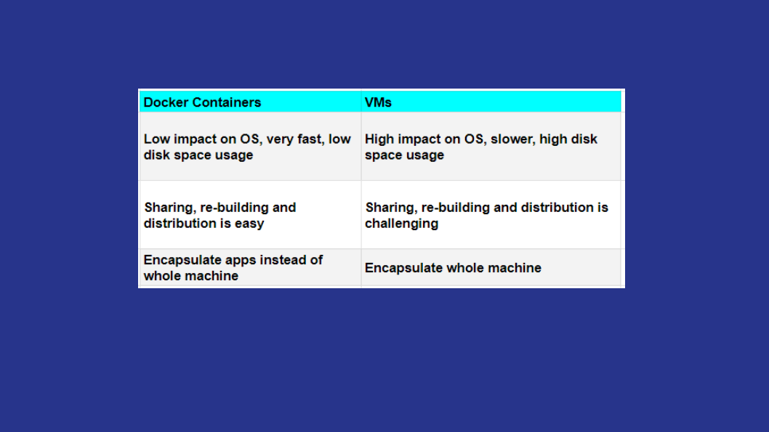

Slide 32
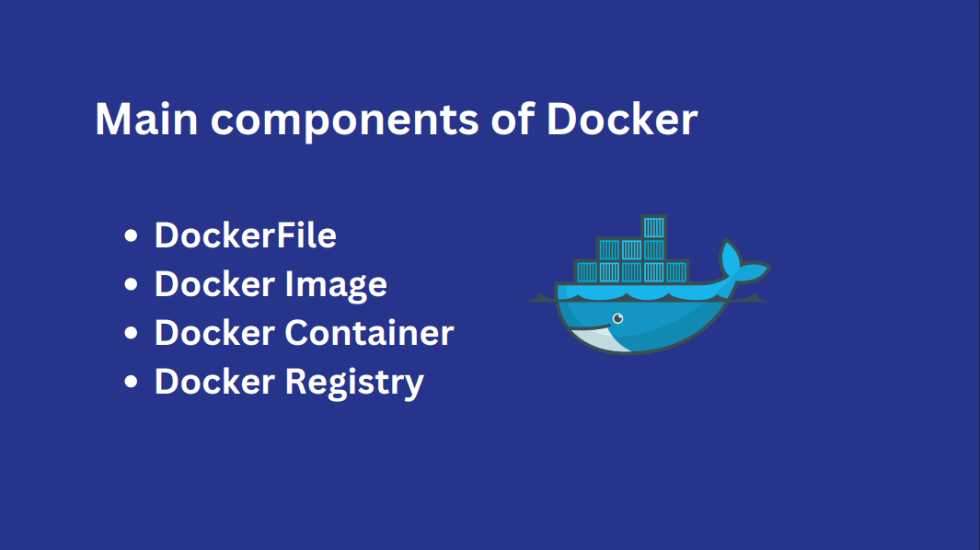

Slide 33

Components of Docker
Docker Daemon
Docker daemon runs on the Host O.S.
It is responsible for running containers, and managing docker services.
Docker daemons can communicate with other daemons.
Docker Client
Docker users can interact with the docker daemon through a client.
Docker client uses commands and Rest API to communicate with the docker
daemon.
When a client runs any server command on the docker client terminal, the
client terminal sends the docker commands to the docker daemon.
Docker clients can communicate with more than one daemon.
Docker Host
Docker Host is used to providing an environment to execute and run
applications. It contains the docker daemon, images, containers, networks,
and storage.

Slide 34
Docker Hub/Registry
Docker registry manages and stores the docker images.
There are two types of registries in the docker.
1) Public Registry → Public registry also called Docker Hub.
2) Private Registry → It is used to share images within the enterprise.
Docker Images
Docker images are the read-only binary templates used to create docker containers. or, a single file with all dependencies and configurations required to run a program.
→ Ways to create an images
1. Take an image from Docker Hub.
2.Create an image from Docker File.
3.Create an image from existing docker containers.
Docker Container
The container holds the entire package that is needed to run the application.
or,
In other words, we can say that the image is a template and the container is a copy of that template.
container is like virtualization when they run on the Docker engine.
Images become containers when they run on the docker engine.

Slide 35
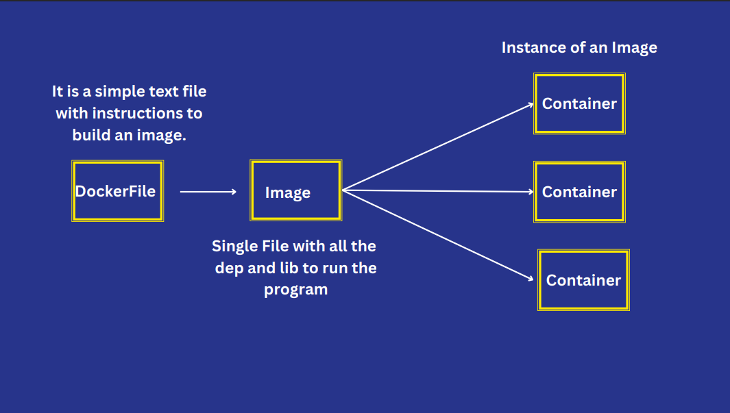

Slide 36
Dockerfile Creation using Dockerfile
Dockerfile
Dockerfile is a text file it contains some set of instruction
Automation of docker image creation
FROM For the base image. This command must be on top of the docker file.
RUN To execute commands, it will create a layer in the image.
MAINTAINER Author/Owner/Description
COPY Copy files from the local system (dockerVM) we need to provide a source, and destination. (We can’t download the file from the internet and anyremote repo)
ADD Similar to copy, it provides a feature to download files from the internet,
also, we extract the file from the docker image side.
EXPOSE To expose ports such as port 8080 for tomcat, port 80 for Nginx, etc…
WORKDIR To set a working directory for a container.
CMD Execute commands but during container creation.
ENTRYPOINT Similar to CMD, but has higher priority over CMD, the first commands will be executed by ENTRYPOINT only.
ENV Environment Variables.
ARG To define the name of a parameter and its default value, the difference between ENV and ARG is that after you set on env. using ARG, you will not be able to access that late on when you try to run the Docker container.

Slide 37
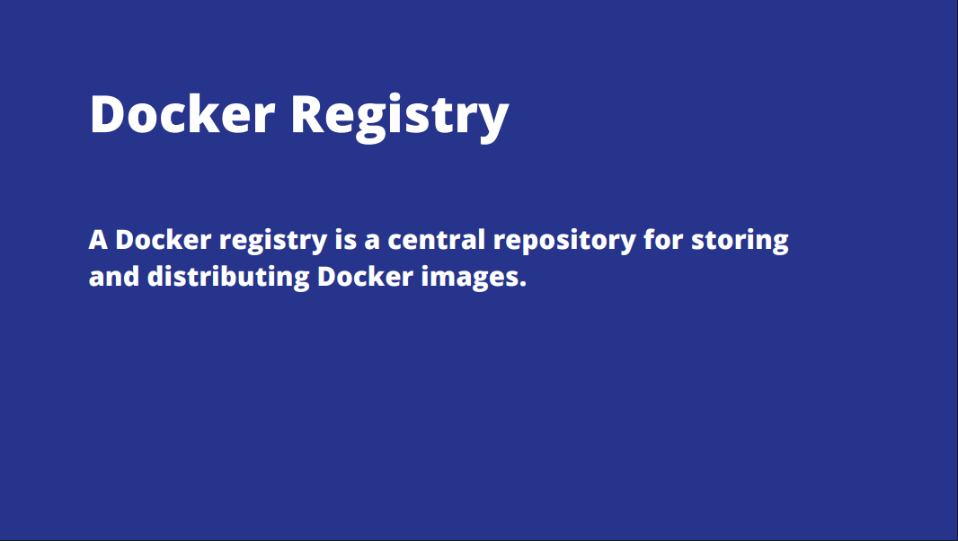

Slide 38
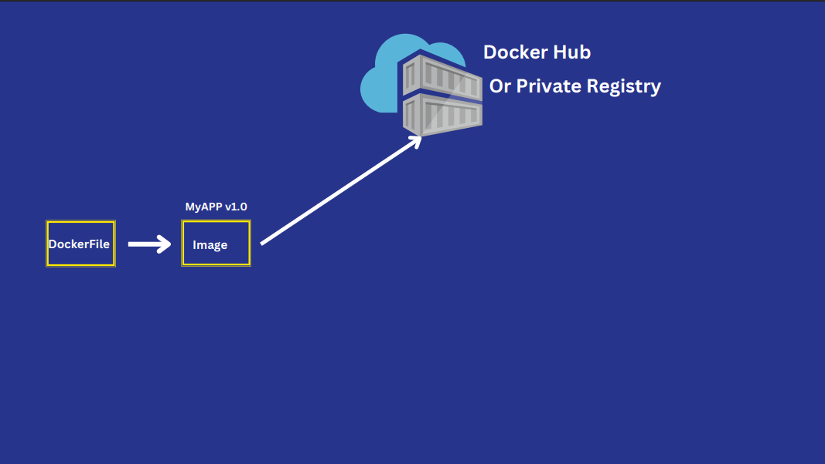

Slide 39
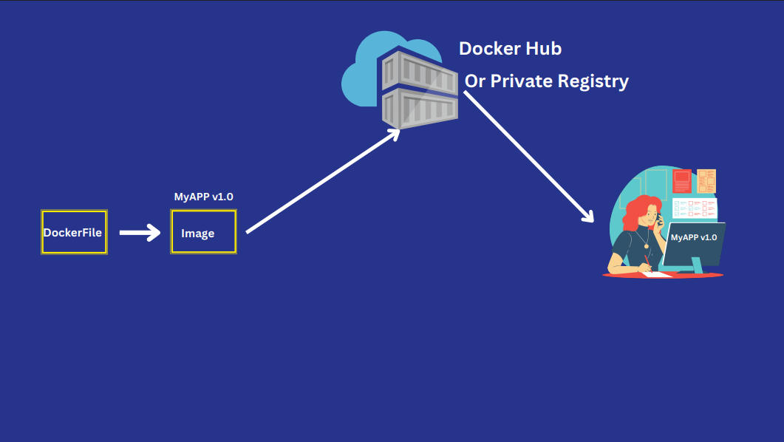

Slide 40
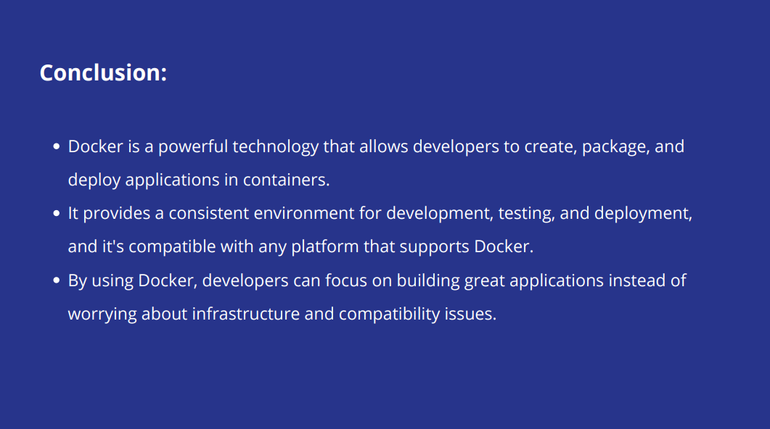

Slide 41
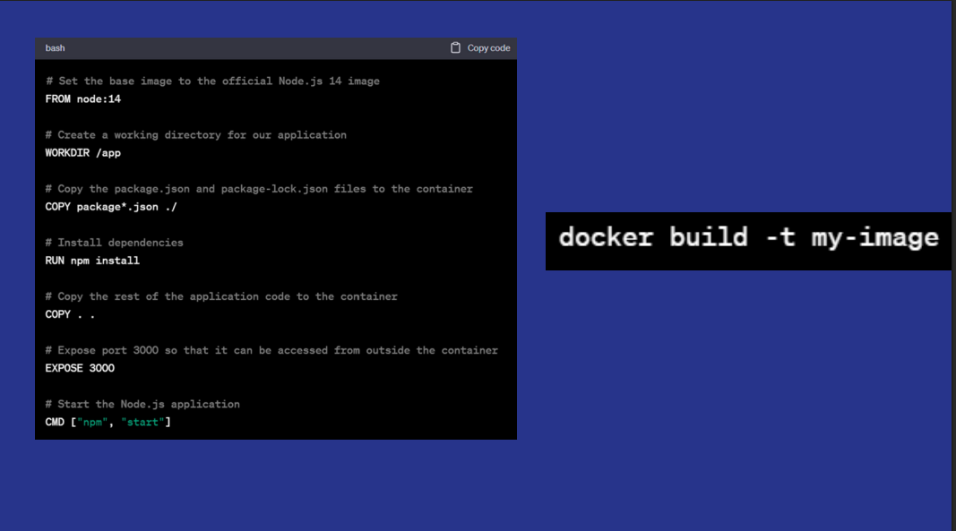

Slide 42
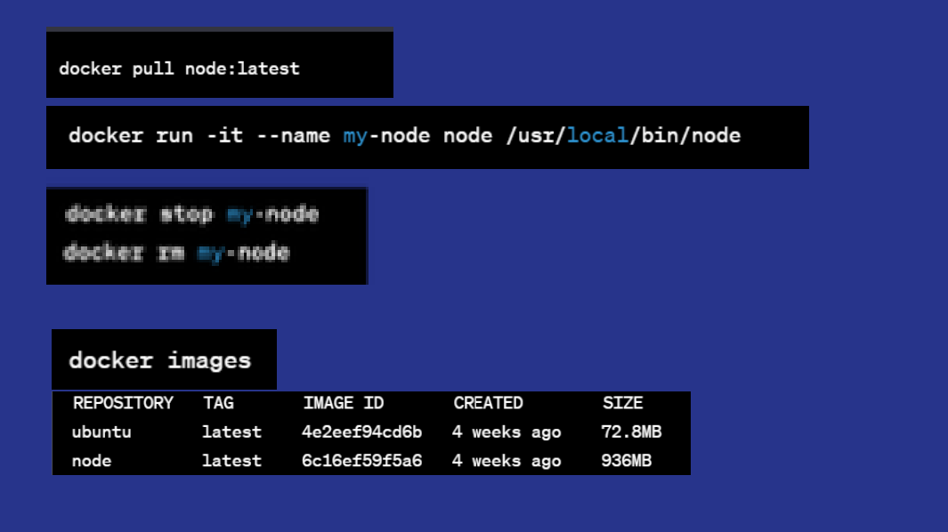

Slide 43
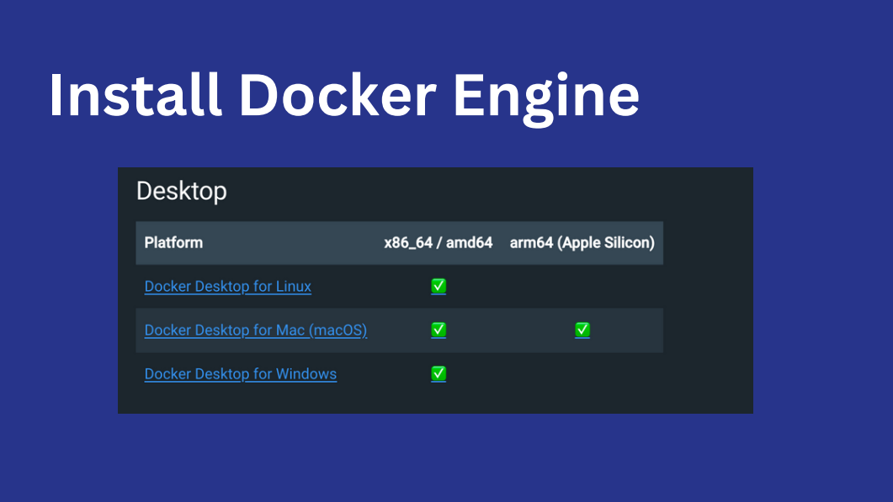

Slide 44
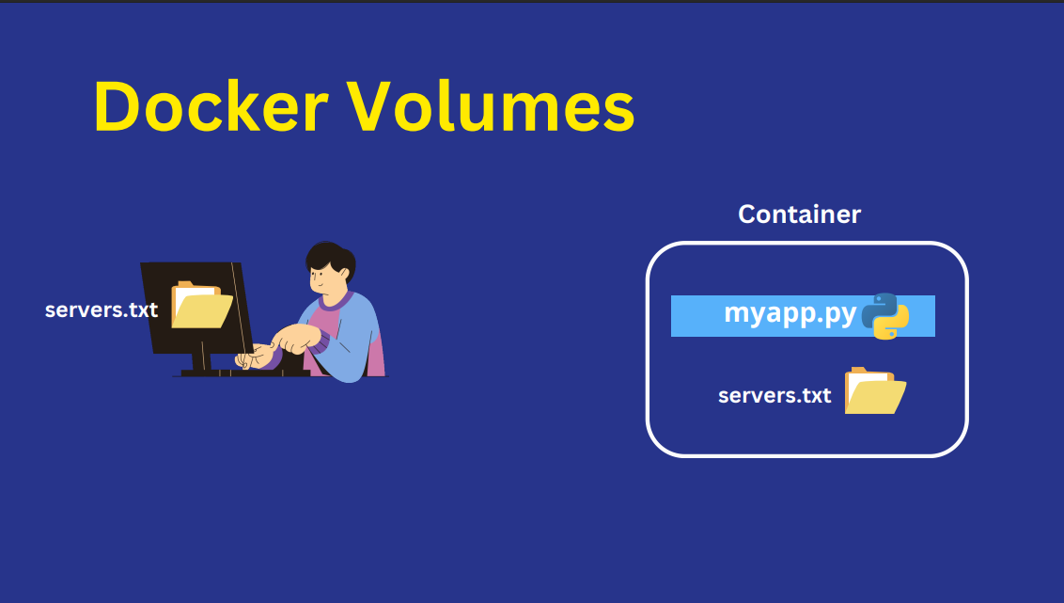


Slide 45
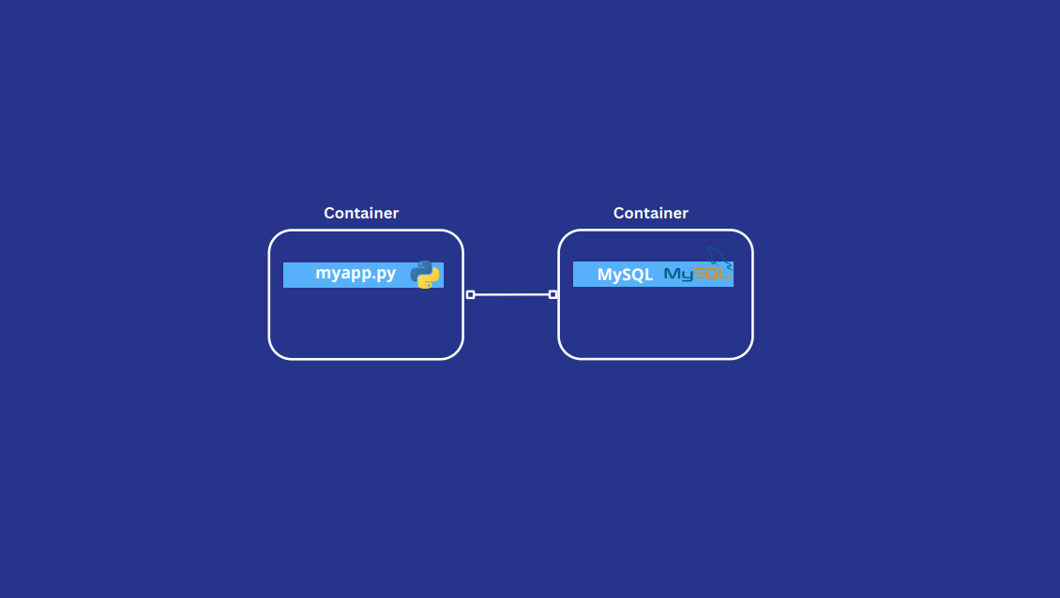


Slide 46
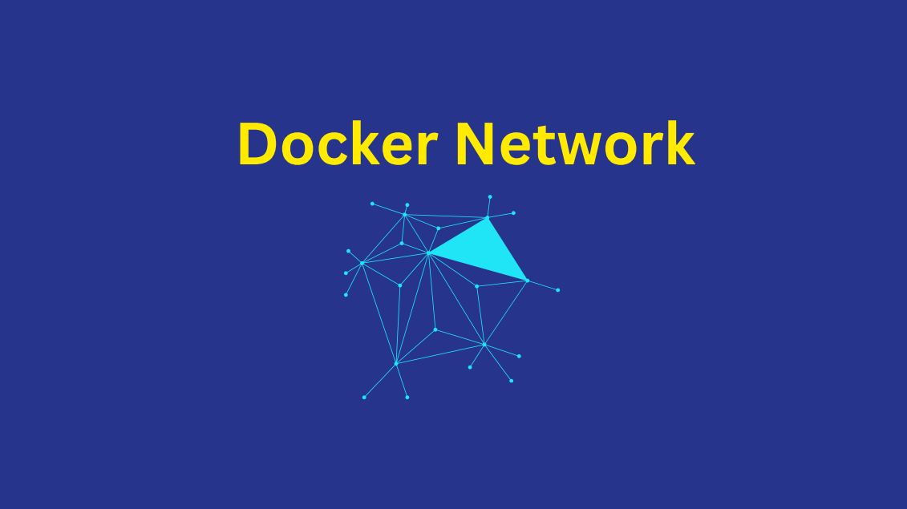
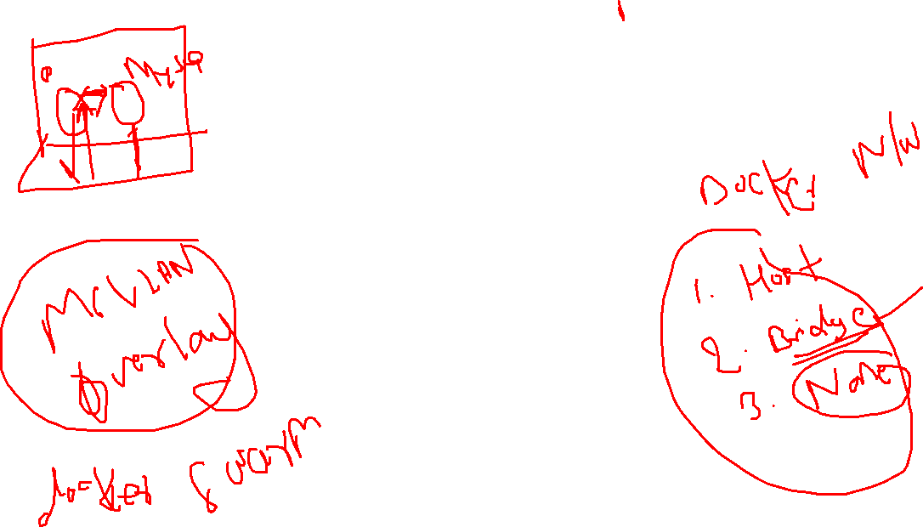

Slide 47
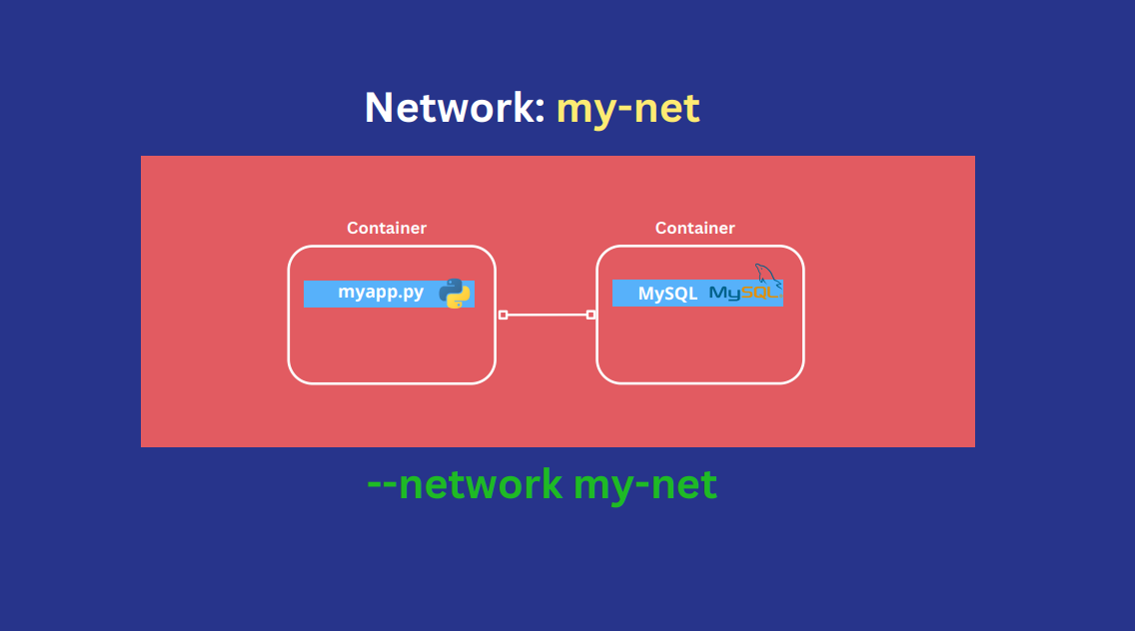


Slide 48
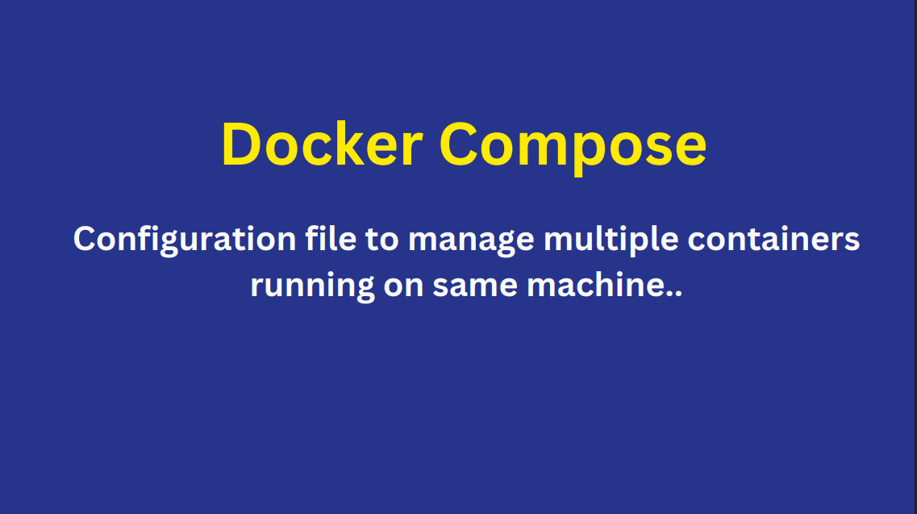

Slide 49
Docker Swarm

Slide 50
1. What is Docker Swarm
2. Why to use it
3. How to create and manage Docker Swarm
4. Create service on docker swarm
5. Scaling services up and down
6. Features/Helpful Tips

Slide 51
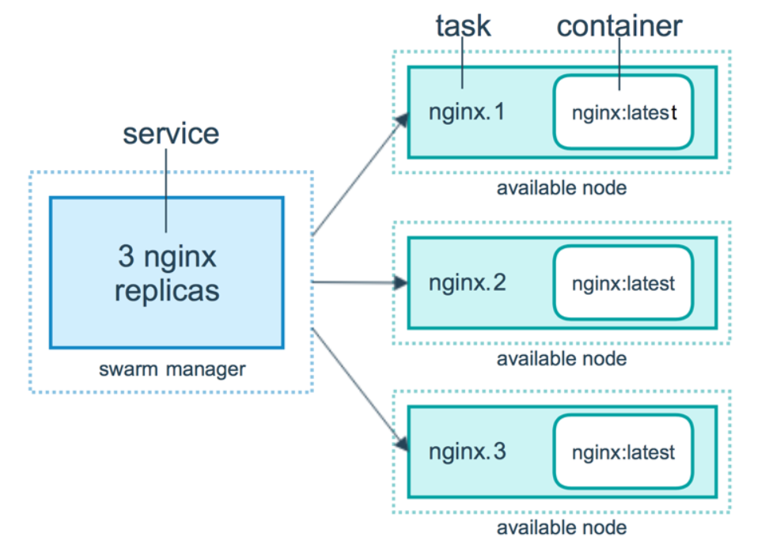
What is Docker Swarm A swarm is a group of machines that are running Docker and joined into a cluster Docker Swarm is a tool for Container Orchestration

Slide 52
Points…..
A swarm is a group of machines that are running Docker and joined into a cluster
A cluster is managed by swarm manager
The machines in a swarm can be physical or virtual. After joining a swarm, they are referred to as nodes
Swarm managers are the only machines in a swarm that can execute your commands, or authorize other machines to join the swarm as workers
Workers are just there to provide capacity and do not have the authority to tell any other machine what it can and cannot do

